Slide 1
LAB2: Building Your Layer 2/3/4 Protocol Stack
TA: Kenuo Xu （许科诺）
Email: kenuo.xu@pku.edu.cn

Slide 2
Goal
You are going to implement a C/C++ program to replace layer 2/3/4 of the kernel protocol stack
Build your own protocol stack is difficult, but worthwhile.
Finishing this lab, you are expected to grow into a system expert (see next page) hopefully.
Application
Transport
Network
We are working on these!
Link
Physical

Slide 3
Two Types of Experts
Domain Experts Use the Infrastructure and Innovate Their Field
System Experts Build and Renovate the Infrastructure
From Guojie Luo

Slide 4
Overview
Implement the 3 protocol layers from bottom to top, with 3 dues.
You need to implement the interfaces we provide between layers.
Feel free to contact us for more clarification and help.
See README.md for more tasks, hints and submit instructions.

Slide 5
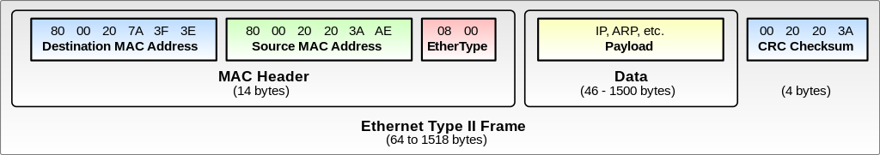
Part A: Link Layer
Make use of libpcap to support sending/receiving Ethernet II frames.
Bottom: libpcap functions, e.g. sending and receiving “framed” bitstreams.
Top: device management, sending/receiving Ethernet II frames.
Due: Oct. 7th.

Slide 6
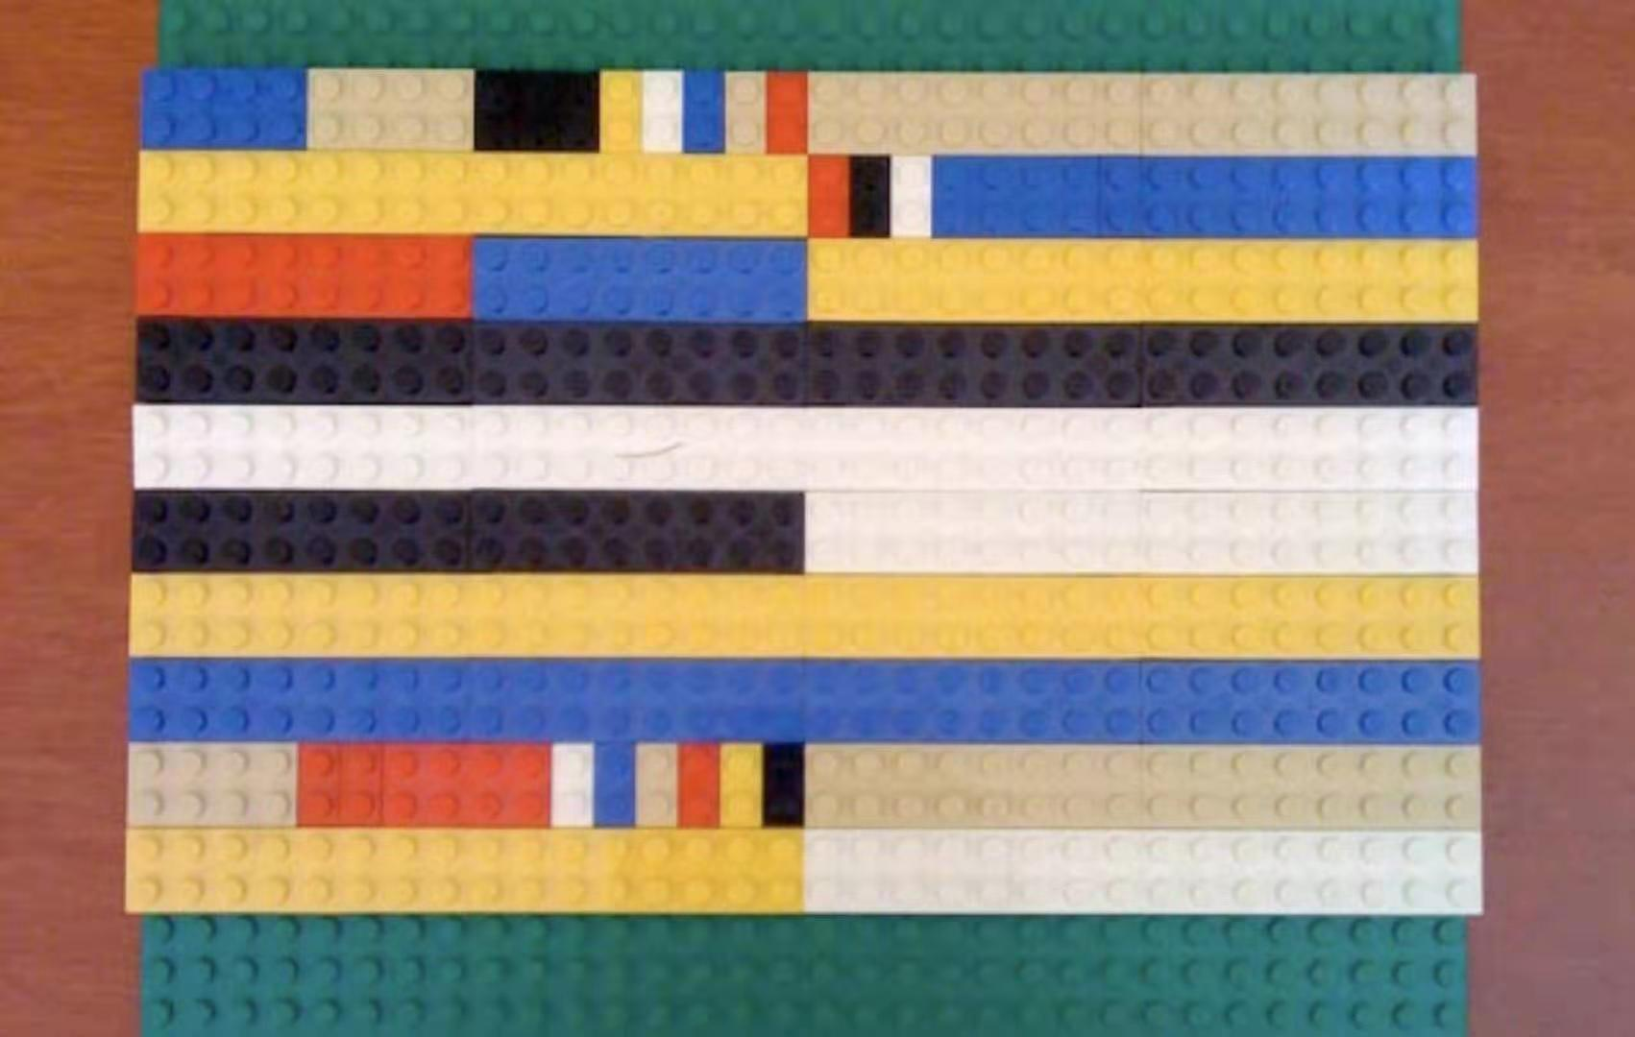
Part B: Network Layer
Implement a simplified version of Internet Protocol version 4.
Bottom: your Ethernet library.
Inside: your routing algorithm.
Top: sending/receiving packets over the whole Internet.
Due: Oct. 21st.

Slide 7
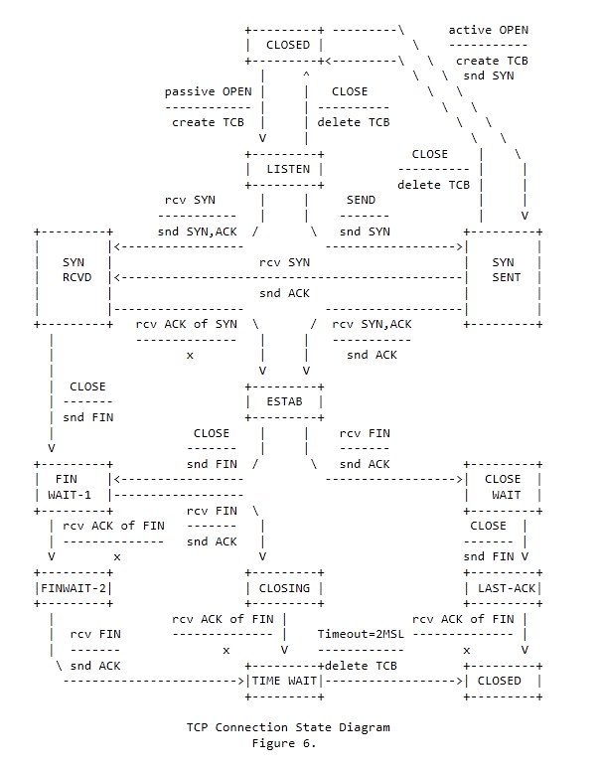
Part C: Transport Layer
Implement a simplified version of TCP protocol, providing a subset of socket interfaces.
Bottom: your IP library.
Inside: connection state machine.
Top: reliable connection via network.
Due: Nov. 18th.

Slide 8
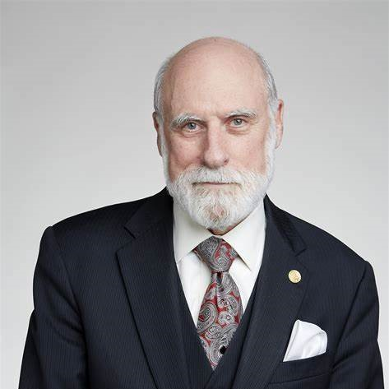
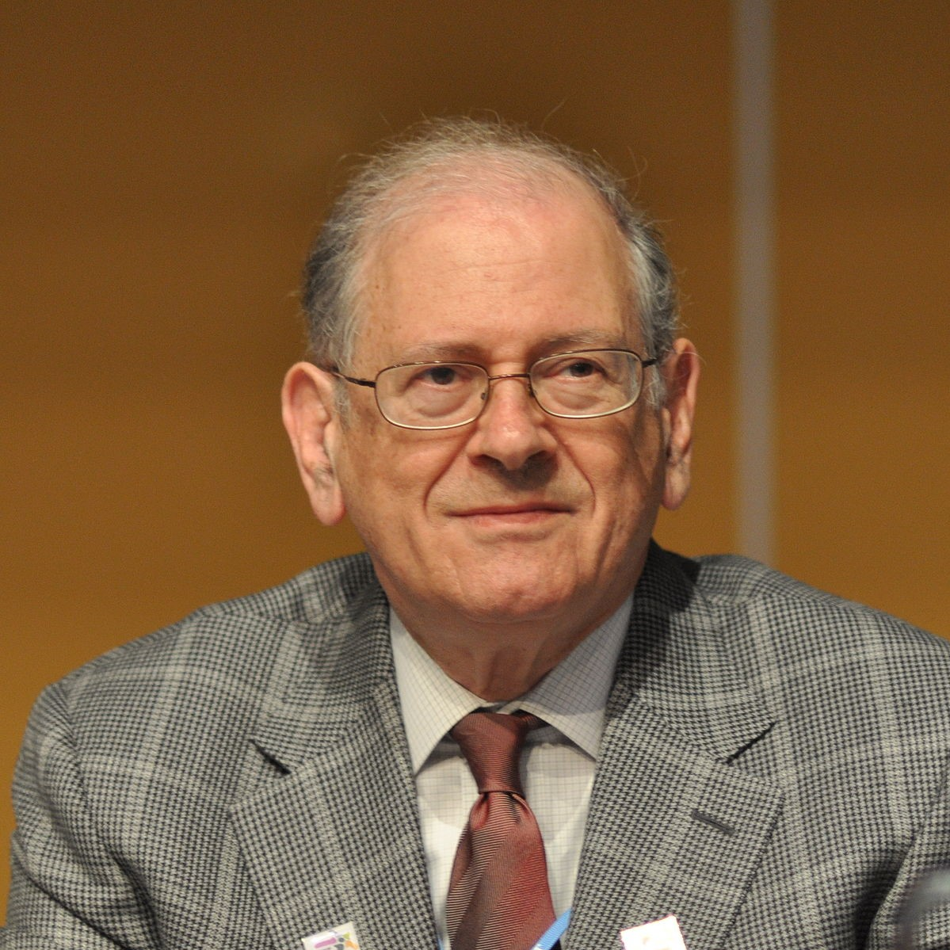
Thanks and Have Fun!
If I have seen further... it is by standing upon the shoulders of giants.
-- Isaac Newton

